Slide 1
Begin
Plan
Estimate
Determine
Control
Conclude
Welcome to Project Cost Management
[1x]
[2x]
This module covers the most important aspects of project cost management required to complete a project in line with our governance standards.
[2x]
[4x]
Notes:
Slide ID: 001
Audio:
[1x] Welcome to this overview on Project Cost Management!
[2x] This module covers the most important aspects of project cost management required to complete a project in line with our governance standards. Let’s begin! [4x] Click “Next” to continue.
Programming Notes: Fade in text in sync with narrator reading each. Show purple bar and International graphic using a wipe animation. Show the white arrow pointing to NEXT at the end of the timeline.
Graphic(s): first slide in template – XX branding

Slide 2
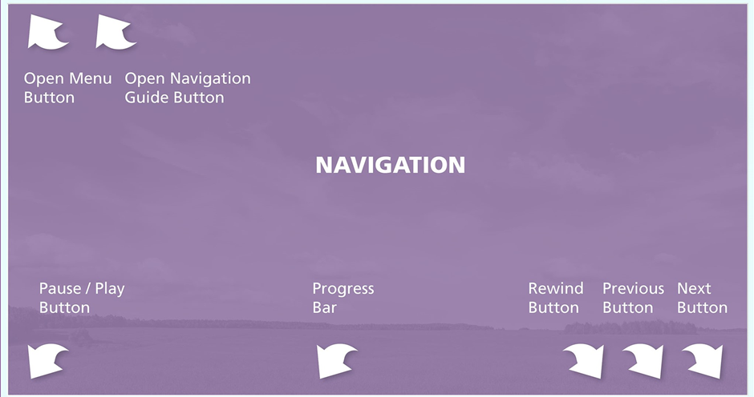
Notes:
Slide ID: 001 lightbox slide
Audio:
none
Programming Notes: This is the navigation lightbox screen to create – it must look exactly like this and it is ok to use this image, or simply keep it in the sample course – the player needs to include Navigation next to Menu.
Graphic(s): XX branding and navigation lightbox. Reference previous courses for this lightbox slide.

Slide 3
Begin
Plan
Estimate
Determine
Control
Conclude
In this module you will learn to:
Recognize the importance of Project Cost Management and how it relates to the project budget.
Use the various techniques to develop effective project cost estimates.
Develop a cost baseline for your project.
Manage your project costs to your baseline.
Manage cost changes.
[5x]
Notes:
Slide ID: 002 continued
Audio:
[5x] In this module you will learn to:
Recognize the importance of Project Cost Management and how it relates to the project budget.
Use the various techniques to develop effective project cost estimates.
Develop a cost baseline for your project.
Manage your project costs to your baseline.
Manage cost changes.
Programming Notes: Same slide as previous….animate previous XX M and PM professor graphics out and animate bullets in and fade in text in sync with narrator reading – use a paragraph animation to sync each learning objective with the narration. Show the white arrow pointing to NEXT at the end of the timeline.
Graphic(s): generic scope image to go with learning objectives

Slide 4
Begin
Plan
Estimate
Determine
Control
Conclude
[6x]
This training module presents a wide range of tools and templates that can be applied by project leaders. Not every tool may apply to your project. Please choose the tools and templates appropriate to your project assignment.
Notes:
Slide ID: 002
Audio:
[6x] This training module presents a wide range of tools and templates that can be applied by project leaders. Not every tool may apply to your project. Please feel free to choose the tools appropriate to the size and nature of your assignment.
Programming Notes: Same slide as previous….. Show the white arrow pointing to NEXT at the end of the timeline.
Graphic(s): generic scope image to go with learning objectives

Slide 5
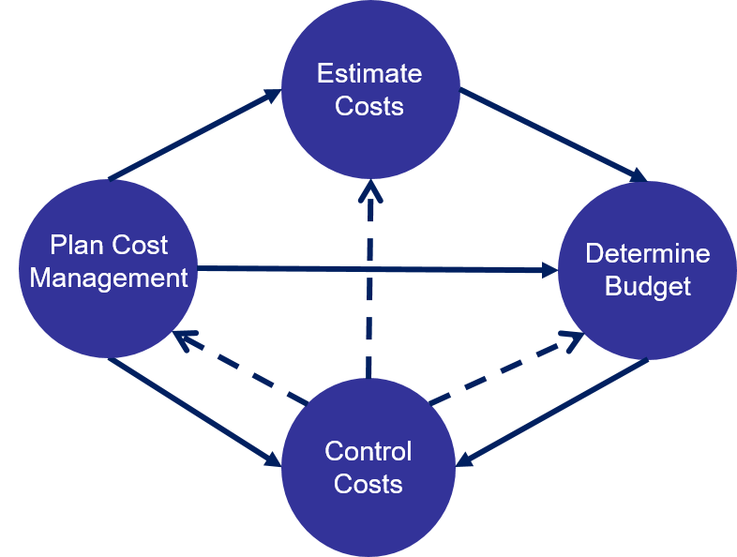
Begin
Plan
Estimate
Determine
Control
Conclude
[1x]
[1x]
Plan cost management
Estimate costs
Determine budget
Control costs
[2x]
These processes are iterative and intertwined with project efforts.
Notes:
Slide ID: 003 continued
Audio:
[1x] Project Cost Management is a holistic process that covers the Cost Management Plan, Cost Estimating, Budget Determination, and Cost Control.
[2x] As shown in this graphic, all of these processes are inter-related and are embedded into the project management agenda throughout the life of the project.
Programming Notes: Animate in purple vertical rectangle, image with blue circles, and fade in text and red bullets in sync with narrator reading each item at [3x] and at [4x], and with red highlight around each blue circle in sync with narration.
Graphic(s): XX branding / colors, scope management process graphic

Slide 6
Begin
Plan
Estimate
Determine
Control
Conclude
What is cost management?
Project Scope dictates the level of costs to be incurred yet availability of funds may place limitations on scope. Changes to the scope of your project may impact cost and shall always be carefully managed and validated with your sponsors via a formal process.
[3x]
How is cost management governed at XX International?
[4x]
How does scope impact cost management?
[5x]
How are stakeholders involved in cost management?
[6x]
Notes:
Slide ID: 003
Audio:
[3x] What is cost management?
[4x] How is cost management governed at XX International?
[5x] How does scope impact cost management?
[6x] How are stakeholders involved in cost management? Click on the purple buttons to reveal the answer to these questions.
Programming Notes: Animate out previous images when purple question boxes appear in sync with narration. Click/reveal interaction: show white fill box with purple text when mouse clicks purple button to the left. Change color of selected box to a lighter purple when it is selected, back to dark when not selected. (see slide 15 example). Show the white arrow pointing to NEXT at the end of the timeline.
Click/reveal questions and answers:
What is cost management?
Cost management refers to the techniques, activities, and tools needed to complete the project to in line with XX International policies and procedures, and within the approved budget.
How is cost management governed at XX International?
Project Cost Management is governed by our policies. Everyone responsible for project management must familiarize themselves with these policies. Please click on PM Professor to access our policies.
How does scope impact cost management?
Project Scope dictates the level of costs to be incurred yet availability of funds may place limitations on scope. Changes to the scope of your project may impact cost and shall always be carefully managed and validated with your sponsors via a formal process.
How are stakeholders involved in cost management?
The project leader should agree the cost management process with the project stakeholders at the outset. The project leader should maintain ongoing stakeholder engagement to make sure they remain aligned and aware of budget utilization, scope and cost changes over the project lifecycle.
Graphic(s): XX branding / colors

Slide 7
Begin
Plan
Estimate
Determine
Control
Conclude
The four cost management processes provide the framework to manage your project costs.
Plan Cost Management
[2x]
[1x]
Estimate Costs
[2x]
Determine Budget
[3x]
[3x]
Control Costs
[4x]
Notes:
Slide ID: 004 continued
Audio:
Project cost management has four steps:
[1x] Plan cost management
[2x] Estimate costs
[3x] Determine budget
[4x] Control costs
Programming Notes: Animate in purple bar wiping down, text at top of screen, and animate in each of the colored boxes in sync with narration as shown. Before the second, third and fourth boxes animate in [#x], animate in the black line and arrow leading to it [#a] using a wipe animation from left to right. Animate in the work performance information text.
Graphic(s): XX branding / colors & images

Slide 8
Begin
Plan
Estimate
Determine
Control
Conclude
[estimate]
The four cost management processes provide the framework to manage your project costs.
Forecasts what each project activity will cost based on the resources required to complete it. It produces activity cost estimates and includes the documentation of assumptions behind the estimates.
Plan Cost Management
Estimate Costs
[determine budget]
Adds up the estimated costs to get a budget for the entire project, producing the cost baseline and project funding requirements.
Determine Budget
[plan]
Documents the policies and procedures, roles and responsibilities to help manage project costs. It may include project return on investment, opportunity cost, and payback expectations.
Control Costs
[control]
Keeps the actual costs and the planned budget in line using [20x] work performance information, cost forecasts, and change request updates. Click on each of the process boxes for details about it.
Notes:
Slide ID: 004
Audio:
These cost management processes provide the framework to manage your project costs. Click on the process boxes for more details.
Programming Notes: Program the white boxes with a black line from it to the appropriate process box to appear as each process box is clicked. Program a hover and visited state for these process boxes. Only one reveal box and line should appear at a time. No voiceover; display text as you click on each box, and only upon going through all boxes can you go next.
Graphic(s): XX branding / colors & images
Click/Reveal:
Plan Cost Management – Documents the policies and procedures, roles and responsibilities to help manage project costs. It may include project return on investment, opportunity cost, and payback expectations.
Estimate Costs – Forecasts what each project activity will cost based on the resources required to complete it. It produces activity cost estimates and includes the documentation of assumptions behind the estimates.
Determine Budget – Adds up the estimated costs to get a budget for the entire project, producing the cost baseline and project funding requirements.
Control Costs – Keeps the actual costs and the planned budget in line using [20x] work performance information, cost forecasts, and change request updates.

Slide 9
Begin
Plan
Estimate
Determine
Control
Conclude
[1x]
Let’s check your knowledge on this section. Click the button below when you are ready to answer a few questions.
Begin Knowledge Check
Start Section Again
[14x]
Notes:
Slide ID: 005
Audio:
[1x] How much have you learned about cost management? Click the “Begin Knowledge Check” button when you are ready to check your knowledge or click the “Start Section Again” button if you want to return to the first slide in this section and review it again.
Programming Notes: Same slide as previous….animate out previous images and text. Fade in text in sync with narrator reading. Show button to click to access the next two questions, and second button to jump to the first slide in this section in case user wants to go through it again before knowledge check. Jump to slide 5 if start section again button is clicked.
Graphic(s): XX branding – knowledge check intro slide

Slide 10
Knowledge Check
Begin
Plan
Estimate
Determine
Control
Conclude
A
It outlines procedures and policies, roles and responsibilities for managing costs. It will also cover change management and escalation processes, reporting formats, and frequency.
Plan Cost Management
Estimate Costs
Determine Budget
Control Costs
B
Using estimation tools and techniques to determine a grounded estimate of the costs of each element in the project.
C
The cost estimate for each work package is added up to get a total for the project and a cost baseline. Then other information is considered, such as the risk register or historical data, to judge whether the estimate is realistic.
D
Keeping the actual costs and the planned budget in line using work performance information, cost forecasts, and change request updates.
Notes:
Slide ID: 006
Audio:
Please match the cost management process step with the appropriate definition. Click on “Check My Work” to discover if you are correct.
Programming Notes: Program a matching question and program the Check My Work button to function as the Submit button. Please reorder the text boxes next to the letter answers so they aren’t in the order shown, but the order does not need to change upon each revisit to the screen. Program this question to allow two tries to answer correctly.
Answers:
Plan cost management – It outlines procedures and policies, roles and responsibilities for managing costs. It will also cover change management and escalation processes, reporting formats, and frequency.
Estimate costs – Using estimation tools and techniques to determine a grounded estimate of the costs of each element in the project.
Determine budget – The cost estimate for each work package is added up to get a total for the project and a cost baseline. Then other information is considered, such as the risk register or historical data, to judge whether the estimate is realistic.
Control costs – Keeping the actual costs and the planned budget in line using work performance information, cost forecasts, and change request updates.
Correct Feedback: Congratulations, you identified the correct process for each activity!
Incorrect Feedback: It looks like you did not correctly identify the process for each activity, but please try again!
Final explanation:
Plan cost management begins with a cost management plan and describes how costs will be estimated and managed.
Estimate costs involved a cost estimate assigned to each work package and then totaled.
Determine budget is when the total cost estimate for each deliverable is added to get a project total. This is further supported by other information - such as the risk register or historical data - to judge whether the budget is realistic.
Control costs involves efforts by the project leader to align actual costs to the planned costs using work performance information, cost forecasts, and change request updates.
Graphic(s): XX branding – knowledge check slide

Slide 11
Begin
Plan
Estimate
Determine
Control
Conclude
Plan Cost Management
[1x]
1
[1x]
[1x]
Plan Cost Management is the first step in the cost management process.
Notes:
Slide ID: 007 continued
Audio:
[1x] Plan Cost Management is the first step in the cost management process.
Programming Notes: animate orange arrow box in with number 1 [1x]. Animate out when images in next instruction slide appear.
Graphic(s): XX branding / colors

Slide 12
Begin
Plan
Estimate
Determine
Control
Conclude
Plan Cost Management
[2x]
[2x]
Focuses on establishing a cost management system for the project.
Notes:
Slide ID: 007 continued
Audio:
[2x] Plan cost management focuses on establishing a cost management system for the project.
Programming Notes: Animate in scope processes circle diagram [2x]. Red highlight should appear when narrator says ‘creation of schedule management plan in [2x].
Graphic(s): XX branding / colors and scope management process graphic

Slide 13
Begin
Plan
Estimate
Determine
Control
Conclude
What is the project cost management plan?
It identifies:
Who is responsible for managing costs
Who has the authority to approve changes to the project or its budget; and the change approval process
How cost performance is quantitatively measured and reported
The report formats, sources of information, frequency, and to whom they are presented
[7x]
What is documented in the cost management plan?
[8x]
What sources of information are helpful to create project cost management plan?
[9x]
Notes:
Slide ID: 007
Audio:
[7x] What is the project cost management plan?
[8x] What is documented in the cost management plan?
[9x] What sources of information are helpful to create project cost management plan?
Click each of the purple boxes to discover the answers to the questions shown.
Programming Notes: Animate in purple box [5x-8x]. Show white fill box with purple text when mouse clicks the purple box to the left. Change color of selected box to a lighter purple (see example on this slide) when it is selected, back to dark when not selected. Show the white arrow pointing to NEXT at the end of the timeline.
Click/reveal questions and answers:
What is project cost management plan? – The Cost Management Plan is a document that clearly defines how the costs on a project will be managed throughout the project’s lifecycle.
What is documented in the cost management plan?
It identifies:
• Who is responsible for managing costs
• Who has the authority to approve changes to the project or its budget; and the change approval process
• How cost performance is quantitatively measured and reported
• The report formats, sources of information, frequency, and to whom they are presented
What sources of information are helpful to create Project Cost management plan?
The project management plan
Project charter
Historical data from similar projects and their post-evaluation studies
External factors (conditions, not under the immediate control of the team, that influence, constrain, or direct the project)
Internal factors including the company’s organizational processes and procedures.
Graphic(s): XX branding / colors

Slide 14
Begin
Plan
Estimate
Determine
Control
Conclude
[1x]
What should the cost
management plan
include?
[1x]
Notes:
Slide ID: 008 continued
Audio:
[1x] What should the cost management plan include?
Programming Notes: Teal man wondering and purple rectangle (using wipe downward) should animate in along with question on other side, then animate text question out when next animations appear in sync with narration in next instruction slide.
Graphic(s): XX branding / colors & image

Slide 15
Begin
Plan
Estimate
Determine
Control
Conclude
[2x]
[2x]
Governance, cost measurements, and reporting formats
Project budget
Cost variance responses
Reallocation of costs
Reduced scope
Reduced quality
Alternative supply solution
Increased budget
Cost change control process
Escalation process
The cost
management plan
includes:
[3x]
[4x]
[5x]
[6x]
Notes:
Slide ID: 008 continued
Audio:
[2x] Governance, cost measurements, and reporting formats;
[3x] project budget – the total amount of money allocated to realize the project;
[4x] the cost variance responses – your approach if over or under spend is identified; the responses may include:
reallocation of costs within the budget positions,
reduced project scope,
reduced quality,
alternative supply solution, or
an increased budget – requiring a supplementary Appropriation Request;
[5x] a cost change control process – how adjustments or cost reallocations will be managed and approved;
[6x] and the escalation process – how to proceed if cost variances cannot be mitigated within approved budget.
Click on PM Professor to learn more about cost control processes and reporting formats.
Programming Notes: Animate in next purple panel using a wipe, and fade or wipe in text along with appropriate bullets, noting that the first two should appear with this screen as they were already covered. Animate out for next instruction slide.
Graphic(s): XX branding / colors

Slide 16
Begin
Plan
Estimate
Determine
Control
Conclude
Reporting formats
The Microsft Portfolio Server / SAP / Capex database are our internal systems that track the costs and expenses of a project. Project reporting occurs from these systems.
Appropriation Request (AR) Policy
Additional budget approval process
Cost change control at XX International is governed by the supplementary AR policy and the Internal Change Order (ICO) procedure. Click on the buttons to view more information.
Internal Change Order (ICO) Procedure
Notes:
Slide ID: 008 lightbox slide
Audio:
none
Programming Notes: Lightbox XX Microsoft Portfolio Server tool and Appropriation Request process accessed by clicking on PM Professor from slide 8. Program this lightbox without any navigation but include a button or option to close the lightbox slide so users can return to slide 8 and the regular navigation. Program the buttons to open resource documents. If you don’t have them to upload to resources, I will do this before publishing to the web, and will link to the docs then.
Graphic(s): XX branding / colors, leads and lags graphics

Slide 17
Begin
Plan
Estimate
Determine
Control
Conclude
[6x]
Let’s check your knowledge on this section. Click the button below when you are ready to answer a few questions.
Begin Knowledge Check
Start Section Again
[1x]
Notes:
Slide ID: 009
Audio:
[1x] How much have you learned about planning cost management? Click the “Begin Knowledge Check” button when you are ready to check your knowledge or click the “Start Section Again” button if you want to return to the first slide in this section and review it again.
Programming Notes: Fade in text in sync with narrator reading. Show button to click to access the next question, and second button to jump to the first slide in this section in case user wants to go through it again before knowledge check. Jump to slide 14 if start section again button is clicked.
Graphic(s): XX branding – knowledge check intro slide

Slide 18
Knowledge Check
Begin
Plan
Estimate
Determine
Control
Conclude
What elements are included in the cost management plan? Drag and drop the correct elements to include.
Cost measurements
Roles & responsibilities for managing costs in the project
Rules for spending
Drop cost management plan
elements here
Project budget
Reporting formats
Cost change control
Escalation process
Cost descriptions
Cost variance responses
Notes:
Slide ID: 010
Audio:
What elements are included in the cost management plan? Drag and drop the correct elements to include in a typical cost management plan.
Programming Notes: Drag and drop question. Program the Check My Work button to function as the Submit button. Program this question to allow two tries to answer correctly. Program the drop so that the dropped items do not overlap each other and can all be read after being dropped.
Question: What elements are included in the Cost Management plan? Drag and drop the correct elements to include.
Roles and responsibilities for managing costs in the project
Reporting formats
Cost measurements
Cost variance responses
Cost change control
Project budget
Escalation process
Incorrect elements include:
Rules for spending
Cost descriptions
Correct Feedback: Congratulations, you matched all the correct elements to include in a cost management plan!
Incorrect Feedback: It looks like you selected one or more wrong elements to include in the cost management plan, but please try again!
Final explanation: A cost management plan can include roles and responsibilities for managing costs in the project, escalation process, reporting formats, cost measurements, cost variance responses, a cost change control process, and the project budget. The rules for spending and cost description are standards across XX International and therefore do not need to be explicitly addressed in the plan.
Graphic(s): XX branding – knowledge check slide

